Slide 1


Quadratics in High School
Kristen Boudreaux, Hahnville High School, Boutte, LA
Ann Davidian, General Douglas MacArthur HS, Levittown, NY

Slide 2
Algebra 1 Standards
A.CED.1 Create equations and inequalities in one variable and use them to solve problems. Include equations arising from linear and quadratic functions, and simple rational and exponential functions.
F.BF.3 Identify the effect on the graph of replacing f(x) by f(x)+k, k f(x), f(kx), and f(x+k) for specific values of k (both positive and negative); find the value of k given the graphs.
  Note: Focus on quadratic functions, and consider including absolute value functions.

Slide 3
Algebra 2 Standards
A.CED.1 Create equations and inequalities in one variable and use them to solve problems. Include equations arising from linear and quadratic functions, and simple rational and exponential functions.
  Note: While functions used will often be linear, exponential, or quadratic, the types of problems should draw from more complex situations than those addressed in Algebra 1.
F.BF.3 Identify the effect on the graph of replacing f(x) by f(x)+k, k f(x), f(kx), and f(x+k) for specific values of k (both positive and negative); find the value of k given the graphs.
  Note: Note the effect of multiple transformations on a single graph and the common effect of each of the transformations across function types.

Slide 4
Differences Between the Courses
In Algebra 1, Quadratic Functions and Modeling is a Critical Area.
  The focus is on understanding how quadratic functions work.
In Algebra 2, the focus is on understanding the effect of various transformations on graphs of functions and how different members of the family of quadratics relate to each other.

Slide 5
What Else is in Algebra 1?
Methods for analyzing, solving, and using quadratic functions
Interpreting various forms of quadratic expressions
Identifying real solutions of a quadratic equation
Creating equations arising from quadratic functions and using them to solve problems (A.CED.2)
Factoring a quadratic expression to reveal the zeros of the function it defines (A.SSE.3a)
Completing the square in a quadratic expression to reveal the maximum or minimum value of the function it defines. (A.SSE.3b)

Slide 6
More from Algebra 1
Derive the quadratic formula by using the method of completing the square. (A.REI.4a)
Solve quadratic equations by various methods. (A.REI.4b)
Interpret the key features of graphs and tables of quadratic functions. (F.IF.4)
Use the process of factoring and completing the square to show zeros, extreme values, and symmetry of the graph, and interpret these in terms of context. (F.IF.8a)
Compare properties of two functions, each represented in a different way. (F.IF.9)
For example, given a graph of one quadratic function and an algebraic expression for another, say which has the larger maximum.
Write a function that describes a relationship between two quantities, focusing on situations that exhibit a quadratic relationship. (F.B.1)

Slide 7

I’m Feeling Overwhelmed!
Don’t!

Slide 8
Factoring
More time to spend on each topic
Time for explorations and discovery
Student centered lessons
Emphasis on deeper understanding

Slide 9
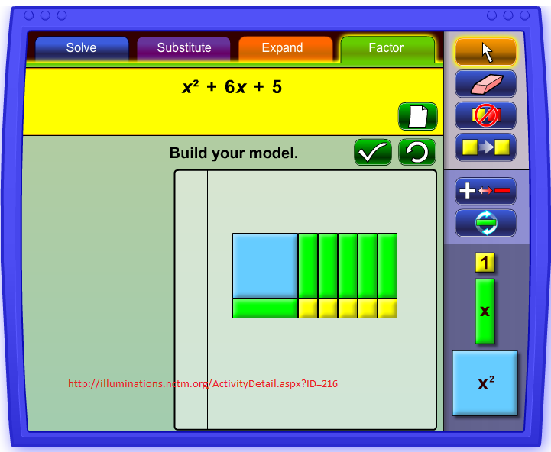
Have you used Algebra Tiles?
Virtual Algebra tiles from NCTM Illuminations
Make your own
Works great to help students understand factoring and completing the square

Slide 10
Some food for thought …
If b is an integer, list all the values of b such that can be factored.
If c is an integer, list all the values of c such that can be factored.

Slide 11
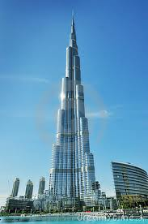
World’s Tallest Building
The Burj Khalifa, in Dubai
2,716.5 feet high
Has more than 160 stories
http://www.burjkhalifa.ae

Slide 12
World’s Tallest Building
At time t = 0 seconds, a small particle falls from the top of the Burj Khalifa building.
At time t, the height of the particle is given by
What is the value of c? Explain.
When would the particle hit the ground?

Slide 13
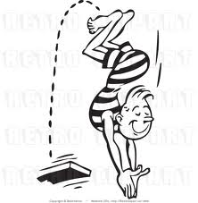
Diving
Diver jumps off a 5 m diving board
Velocity is 6m/sec
Height, in meters above the water, in t seconds, t>0.

Slide 14
Diving
How long is the diver in the air before he hits the water?
What is the maximum height the diver reaches?
When does he reach his maximum height?
If the diver jumped from a 10 m platform, how would the equation for h(t) change?
Would this change affect your answers to the first three questions? Explain.

Slide 15
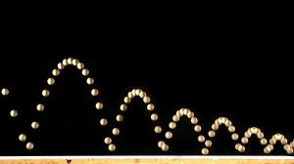
Student Experiments
Students collect the height versus time data of a bouncing ball using a motion detector.
Graph and interpret a quadratic model to fit the data.
Probes are available for computers and graphing calculators.

Slide 16
Motivate with a Video Clip
Show “Projectile Motion & Parabolas”, one of ten videos in the series, “The Science of NFL Football” funded by the National Science Foundation and produced in partnership with the NFL.
Show a video clip of a basketball player shooting a basket.
Show a film clip of “October Sky,” the true story of Homer Hickam, a coal miner’s son, who became a NASA engineer. Homer used his knowledge of projectile motion to prove that his rocket could not have started a fire when it landed.
Ask probing questions to test students’ understanding of what they are seeing.

Slide 17
Stopping Distance
Typical values for stopping distance
http://arachnoid.com/lutusp/auto.html
Speed (mph) | Stopping Distance (ft)
20 | 64
30 | 111
40 | 168
50 | 235
60 | 312

Slide 18
Stopping Distances
Write an equation to model the stopping distance, d, in feet, of a car traveling at v miles per hour.
Use your equation to determine how fast a car was going when it braked, if the stopping distance of the car was 500 feet.
Taken from “Algebra: Form and Function”
William McCallum, Eric Connally, Deborah Hughes Hallett et al., John Wiley, 2010

Slide 19
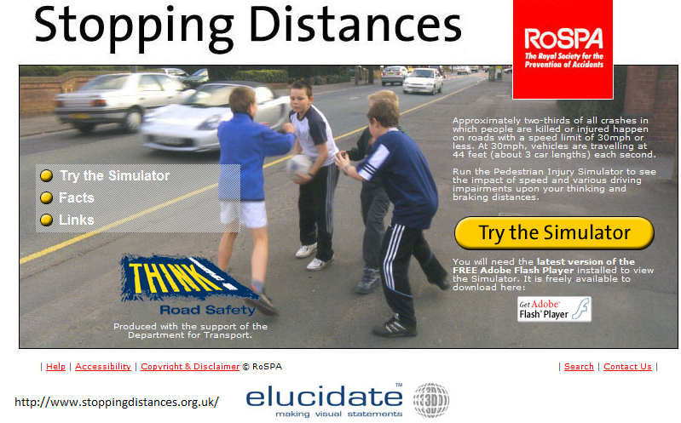
Stopping Distance Simulator
Approximately two-thirds of all crashes in which people are killed or injured happen on roads with a speed limit of 30mph or less.
This simulator shows the impact of speed and various driving impairments upon your thinking and braking distances.

Slide 20
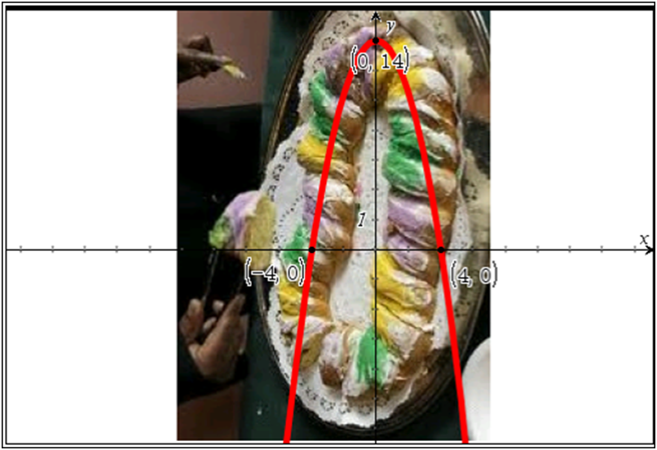
King Cake
A king cake is part of the Mardi Gras tradition in New Orleans.
Write an equation for the parabola shown.
Answer the questions from your handout.

Slide 21

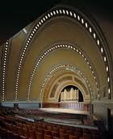
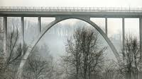
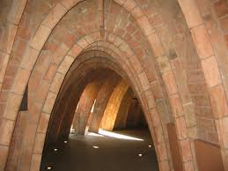

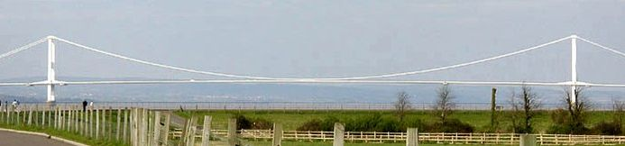
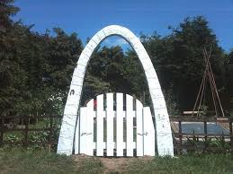
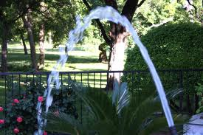
Other Pictures to Think About
Perhaps you prefer a different model

Slide 22
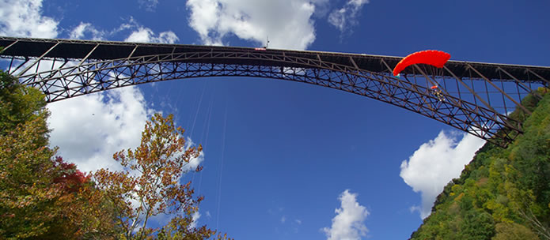
New River Gorge Bridge
Longest steel arch bridge in the Western Hemisphere.
Second tallest Bridge in the United States.
http://www.officialbridgeday.com/bridge-day-history-facts

Slide 23
New River Gorge Bridge
The bridge’s height, in feet, at a point x feet from the arch’s center is
What is the height at the top of the arch?
What is the span of the arch at a height of 575 feet above the ground?
Taken from “Algebra: Form and Function”
William McCallum, Eric Connally, Deborah Hughes Hallett et al., John Wiley, 2010

Slide 24
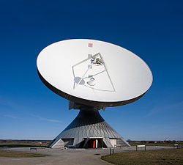
Does Anyone Use Parabolas?
A parabolic antenna uses a curved surface with the cross-sectional shape of a parabola to direct the radio waves.
Its main advantage is that it can direct radio waves in a narrow beam.
http://en.wikipedia.org/wiki/Parabolic_antenna

Slide 25
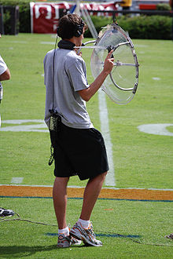
Parabolic Microphone
Uses a parabolic reflector to collect and focus sound waves onto a receiver
Check the internet to learn how to make your own!
http://en.wikipedia.org/wiki/Parabolic_microphone

Slide 26

Flashlights
A flashlight’s bulb is placed at the focus of a parabolic reflector.
See a simulation of the use of different types of reflectors.
http://www.maplesoft.com/applications/view.aspx?SID=5523&view=html

